Slide 1
SALT LAB
Notes:
Its been a long week with mid terms and other assignments. And as a result of which I was not able to join the last call.

Slide 2
Progress and Findings till date
Analysis and cleaning of dispatcher-victim dataset.
Sentiment extraction and graphing done using Bert-perspectives to get features of emotional transition between conversation and gauge total emotion of the sentence.
Transform the dataset and perform statistical analysis on the data to understand trends and patterns in the conversation.
Investigate the different methods to mitigate the issues discussed above.
Notes:
Talking about my progress and finding till now,
- I receivd a dispatcher-victim data from Yiren for analysis.
- On further inspection, the dataset did contain certain ambigious conversations which required to be cleaned. I used certain libraries such as texthero to cleanse the dataset.
- I had used a pretrained model called BERT-Perspectives to extract sentiment of each sentence within the conversation and corrolate it with the sentiment for the entire dataset.

Slide 3
Assumptions
Entries with a single conversation have been omitted.
Only the top 100 conversations have been analyzed due to heavy computing requirements.
Notes:
Lets look at some of the conditions and assumptions that we have made during t

Slide 4
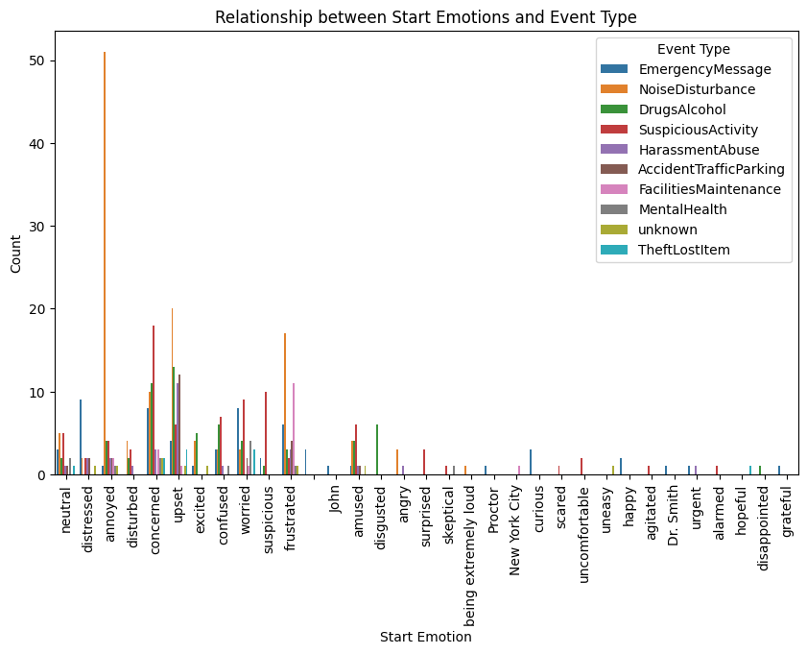
Emotional Analysis for the dispatchers and users
Notes:
We performed some statistical analysis on the emotion aspect of the dataset.
Common starting emotions include neutral, concerned, upset, annoyed, and distressed.
We can also see that

Slide 5
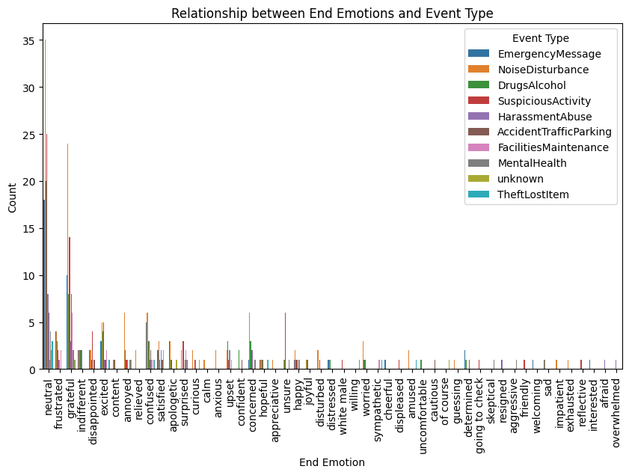
Relationship between End Emotions and Event type
Notes:
Common ending emotions include neutral, grateful, excited, and frustrated. This indicates that despite starting in various emotional states, there's a tendency towards certain emotional resolutions mentioned above.

Slide 6
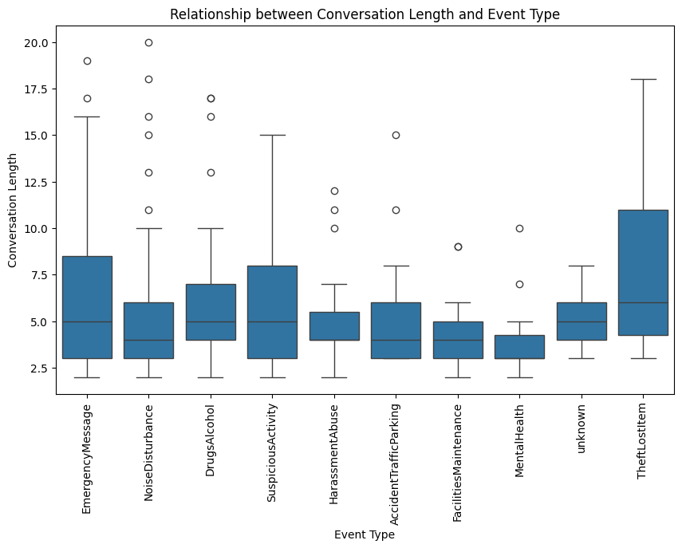
Relationship between Conversation Length and Event type
Notes:
Talking about the relationship between conversation length and event type,
Reponses relating to emergency messages and lost times always take a lot of time to respond.

Slide 7
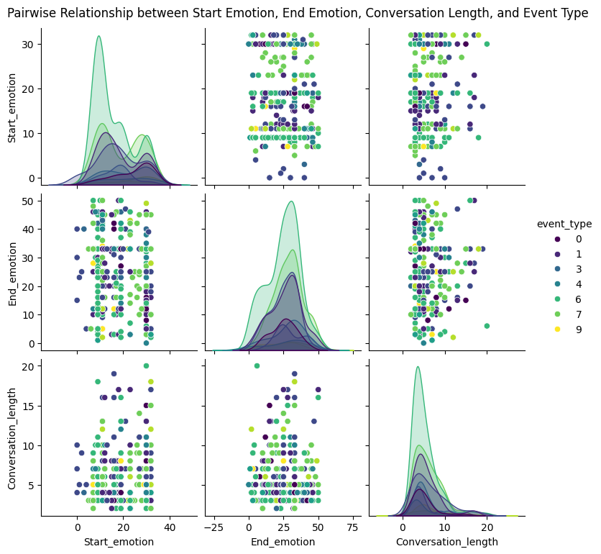
Notes:
“NoiseDisturbance”, “EmergencyMessage”, “DrugsAlcohol”, and “SuspiciousActivity” are frequent event types, showing the range of issues encountered.
Certain event types might correlate with specific start and end emotions. For example, "NoiseDisturbance" events might commonly start with "annoyed" or "upset" and end with "neutral" or "grateful". This suggests that the nature of the event significantly influences emotional trajectories.

Slide 8
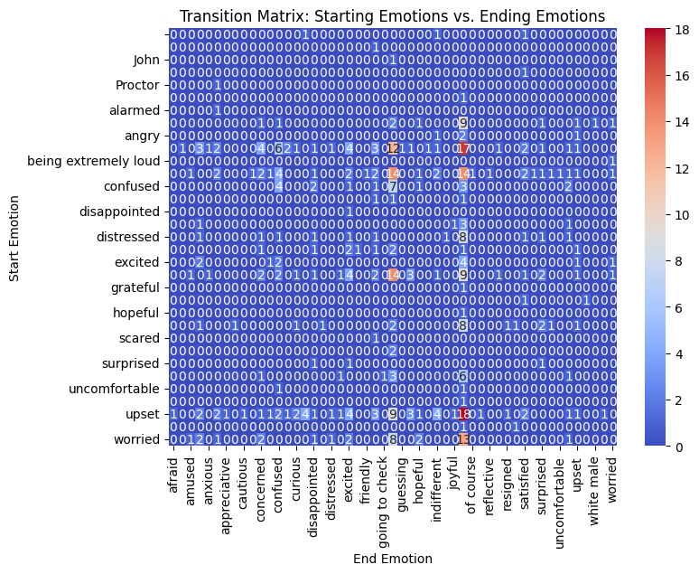
Heatmap showing relationship between starting and ending emotions

Slide 9
Inferences
Common starting emotions include neutral, concerned, upset, annoyed, and distressed.
Common ending emotions include neutral, grateful, excited, and frustrated. This indicates that despite starting in various emotional states, there's a tendency towards certain emotional resolutions mentioned above.
“NoiseDisturbance”, “EmergencyMessage”, “DrugsAlcohol”, and “SuspiciousActivity” are frequent event types, showing the range of issues encountered.

Slide 10
Continuation
Certain event types might correlate with specific start and end emotions. For example, "NoiseDisturbance" events might commonly start with "annoyed" or "upset" and end with "neutral" or "grateful". This suggests that the nature of the event significantly influences emotional trajectories.
Longer conversation lengths might be associated with more complex emotional journeys. For example, events starting with "distressed" and ending in "neutral" might have longer conversation lengths, implying that time is needed to navigate the distress.

Slide 11
Continuation
Specific events types, like "EmergencyMessage" and "SuspiciousActivity", might have variable conversation lengths, suggesting varied degrees of complexity and resolution times.

Slide 12
How do we improve dispatcher efficiency without compromising on the ability of capture knowledge from inference.
Most dispatcher-user scenarios have a common pattern, which the LLM would understand. For e.g., a public disturbance model would always include asking the victim about the type of commotion and other aspects of it, which can be generalized by constructing a knowledge graph.
As a result of which, the dispatcher module would always reference the constructed and optimized KG for the next step of action. We can see an sample example on the next slide.
Notes:
How do we reduce time to resolution (TTR) using a LLM?

Slide 13
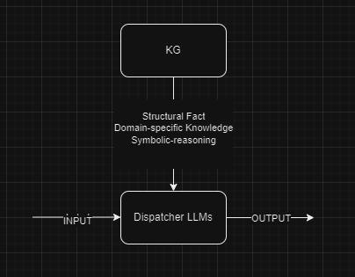
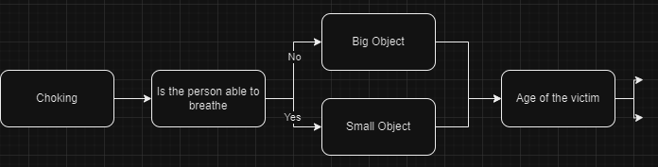
Continuation
Notes:
This is how a typically KG would look for one of our usecase. Lets say, we have a case where a child is choking.
A generalized pipeline would be to first check if the person irrespective of their age if they can breathe freely.
If the person cannot brethe, then the LLM can place a call to the nearest emergency service and can also provide with instruction to the caller to alleviate the choke.
If Yes, then we can ask the type of object/food that has been taken in.
What this does is structuring the facts for the LLM at the same time collecting information from the user so that the LLM can suggest certain ways to help the caller and we are also making it domain specific.
Symbolic reasoning in large language models (LLMs) refers to the ability of these models to perform logical deductions, infer relationships, and manipulate symbols to solve complex problems.

Slide 14
Conclusion
By examining the configuration and substance of the knowledge graph, LLMs can draw logical conclusions and uncover further insights rapidly, proving beneficial in addressing intricate problems.
LLMs can leverage knowledge graphs to better understand the context of a given issue or problem. By analyzing the relationships between different entities within the knowledge graph, LLMs can infer relevant information and context, enabling them to provide more accurate and comprehensive responses, thereby negating hallucinations.
By analyzing the structure and content of the knowledge graph, LLMs can make logical deductions and infer additional insights at a, which can be valuable for resolving complex issues.
https://arxiv.org/pdf/2306.08302.pdf
Notes:
The possible next steps could be to construct a knowledge of various common senrarious and feed it to the dispatcher bot that both Yiren and Yerong have developed.
Construction of KGs can be done manually or we can train a LLM to construct one or just use a SOTA model such as GPT4 to construct one for us.
We can then use metrics that we saw in the earlier slides to MTTR to check for improvements in the dispatcher model after the implementation of KGs

